Slide 1
Group 5
Celia Schmidt, Simon Drabert, Chris Vogel, Franck Polin

Slide 2
What is the project about?
See next slide

Slide 3
What is the objective of our project?
Experiment on a solution design for the automated answering of course related questions from students
Support provided to students
without requiring the attention of the teacher
24/7 no time delays (immediate answer)
Proof of concept for further development of automated student support

Slide 4
Why do we think our project is appropriate?
Going towards digital transformation of FHNW
Complexity level justifies the use of Agile

Slide 5
Is the WHO defined?(Stacey Matrix)
Team
Friedrich Witschel
Project coach
Other? (e.g. students of BI course, external help)

Slide 6
What about the WHAT?(Stacey Matrix)
A tool to provide answer questions related to the Business Intelligence course
For the students
Without having to write an E-mail to Teacher
Automated (24/7) support

Slide 7
And HOW?
Develop a chatbot?
Machine learning? Supervised learning?
Knowledge engineering?

Slide 8
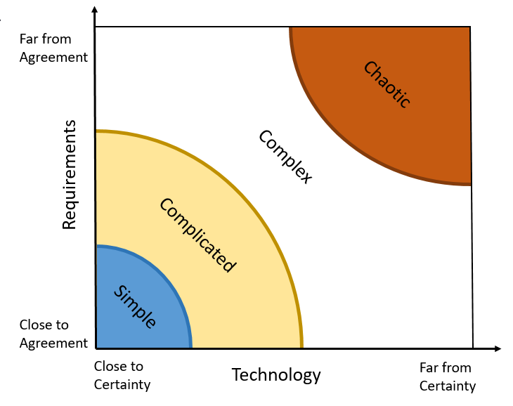
Sooo? Where are we?
Develop a chatbot?
Machine learning? Supervised learning?
Knowledge engineering?
Somewhere here

Slide 9
What is the situation?

Slide 10
What are our expectations?

